Slide 1
Presented By:
YASH JAISWAL

Slide 2
CAR PRICE PREDICTION
1) car market
2) Value for Money
3) used cars
4) Facing problems
5) SUV, Sedans, Coupe, minivan, Hatchback.

Slide 3
INTRODUCATION
1) Repurchase of cars
2) key of purchase
3) Trust and net benefit
4) scrape Data
5) Car price valuation model.

Slide 4
PROBLEM STATEMENT
With the covid 19 impact in the market, we have seen lot of changes in the car market. Now some cars are in demand hence making them costly and some are not in demand hence cheaper. One of our clients works with small traders, who sell used cars. With the change in market due to covid 19 impact, our client is facing problems with their previous car price valuation machine learning models. So, they are looking for new machine learning models from new data. We have to make car price valuation model. This project contains two phase
You have to scrape at least 5000 used cars data. You can scrape more data as well, it’s up to you. more the data better the model In this section You need to scrape the data of used cars from websites (Olx, cardekho, Cars24 etc.) You need web scraping for this. You have to fetch data for different locations. The number of columns for data doesn’t have limit, it’s up to you and your creativity. Generally, these columns are Brand, model, variant, manufacturing year, driven kilometers, fuel, number of owners, location and at last target variable Price of the car. This data is to give you a hint about important variables in used car model. You can make changes to it, you can add or you can remove some columns, it completely depends on the website from which you are fetching the data. Try to include all types of cars in your data for example- SUV, Sedans, Coupe, minivan, Hatchback.

Slide 5
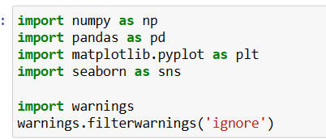
LIBRARIES

Slide 6
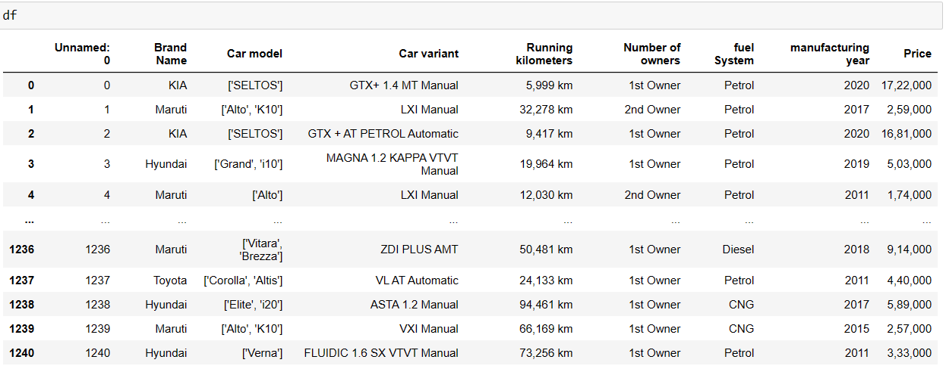
DATASET

Slide 7
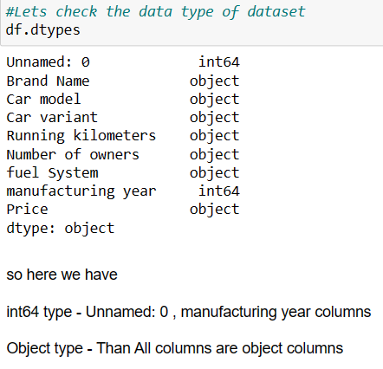
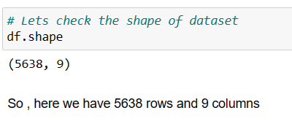
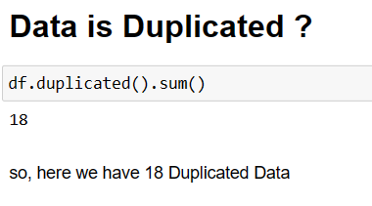
Exploratory Data Analysis(EDA)

Slide 8
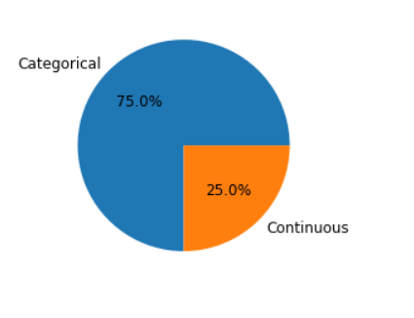
VISUALIZATIONS

Slide 9
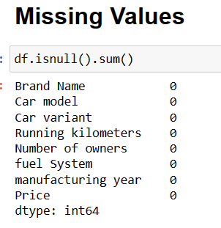
NULL VALUES

Slide 10
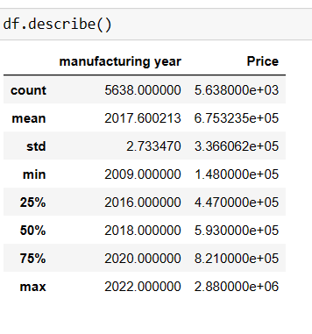
DATA DESCRIBE

Slide 11
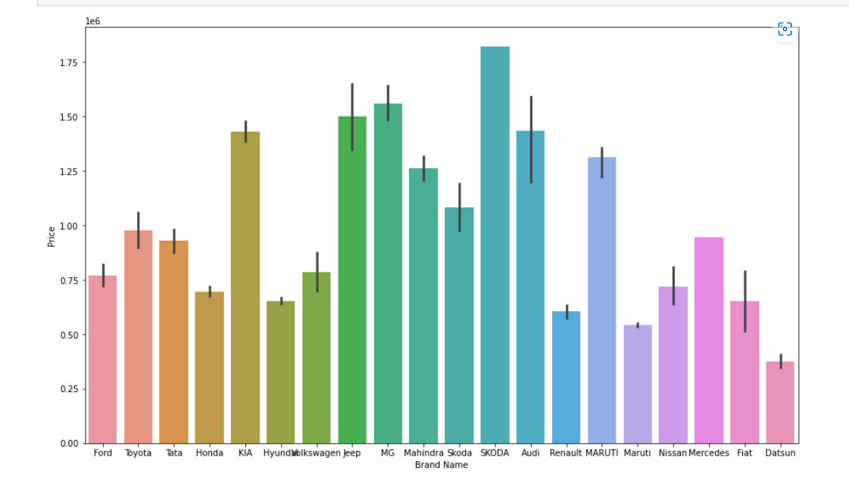
Brand Name vs Price => Skoda

Slide 12
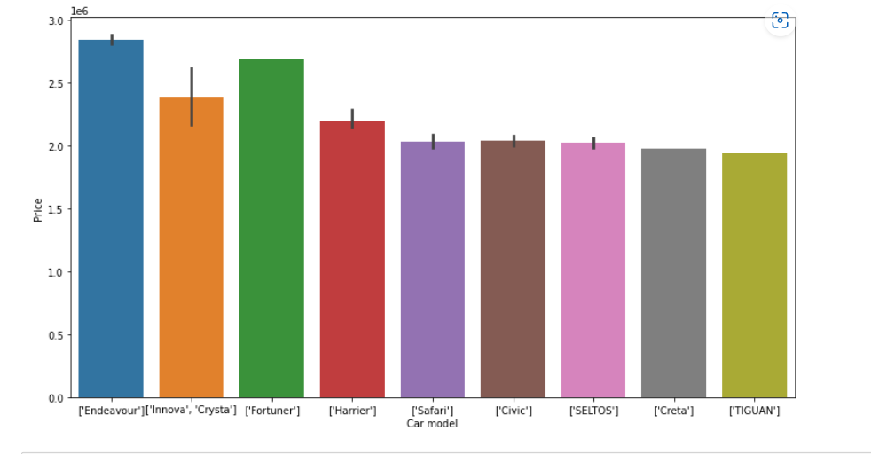
Car Model vs Price => Endeavpor

Slide 13
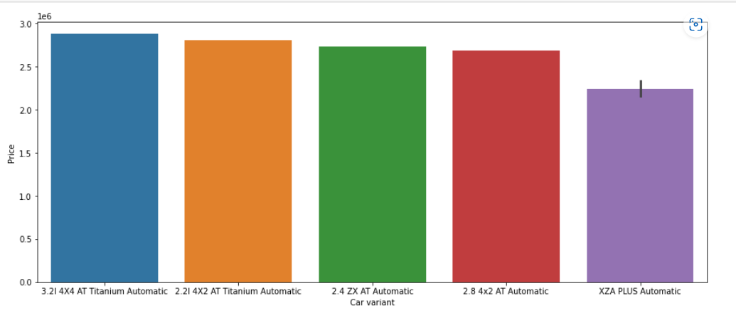
CAR Variant

Slide 14
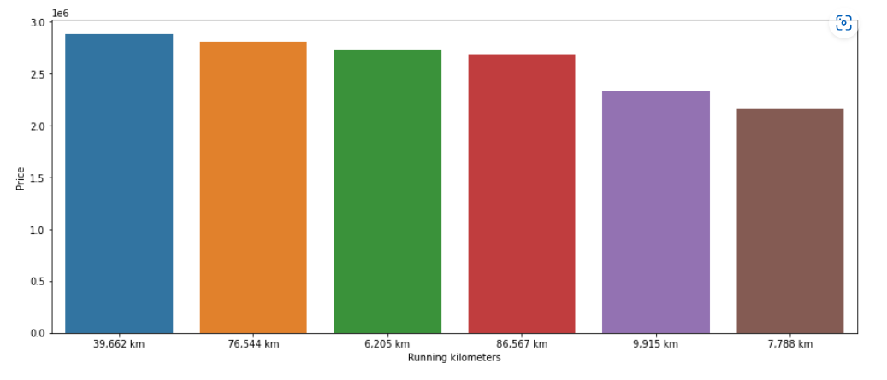
Running Kilometers

Slide 15
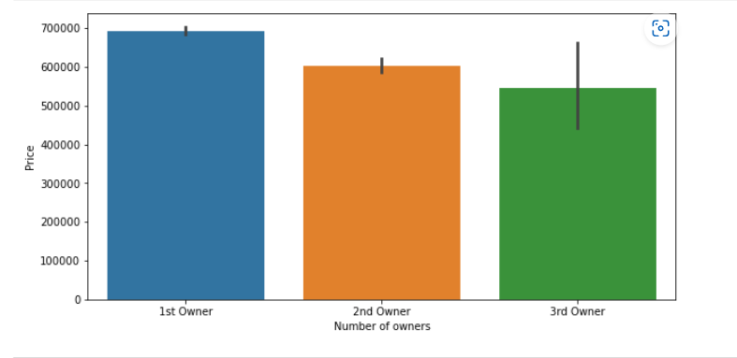
NUMBER OF OWNER

Slide 16
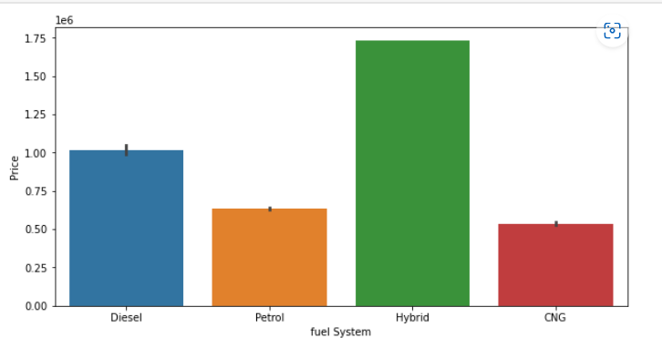
FUEL SYSTEM

Slide 17
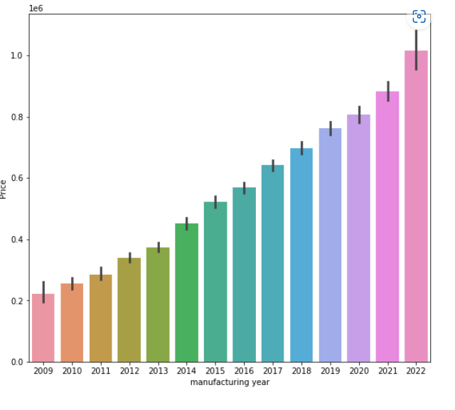
Manufacturing year

Slide 18
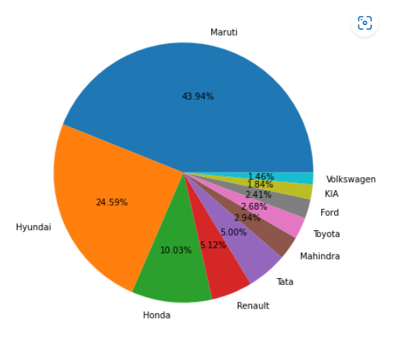
Top 10 car brand

Slide 19
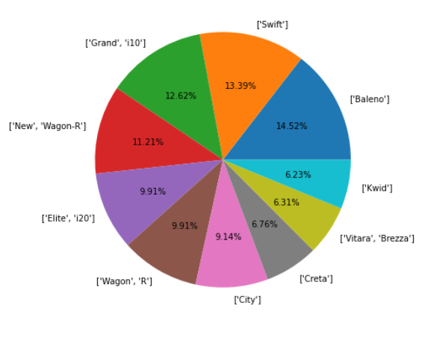
Top 10 car model

Slide 20
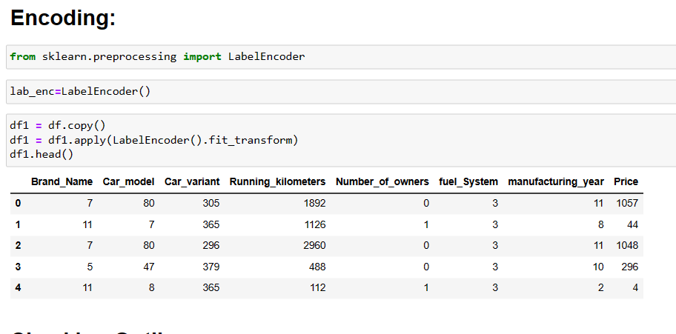
ENCODING

Slide 21
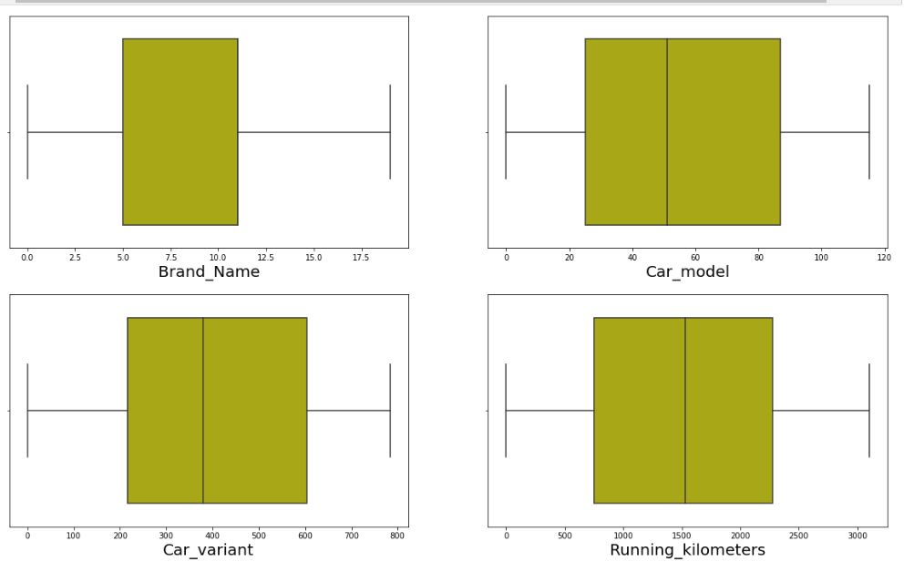
Checking Outliers

Slide 22
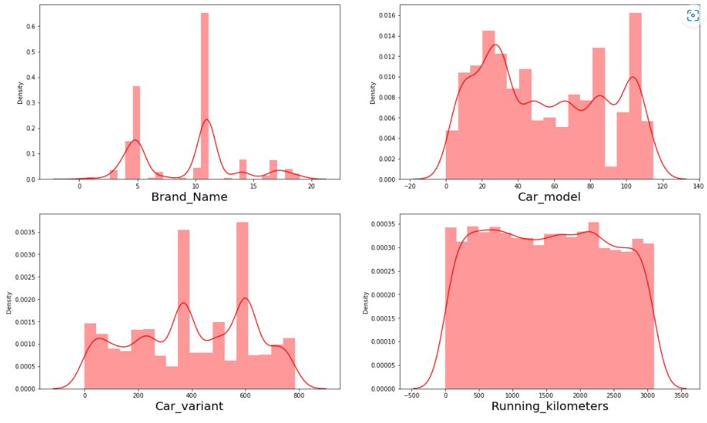
Skewness

Slide 23
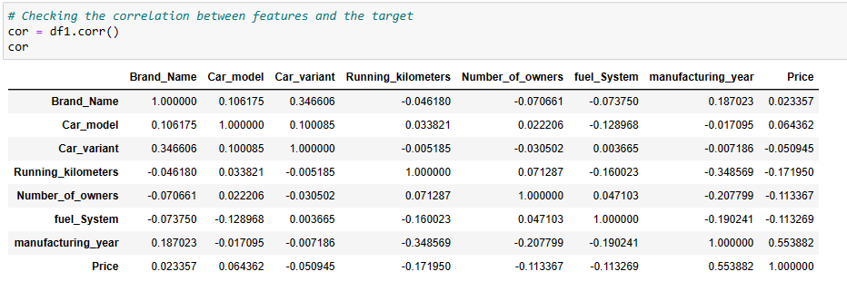
CORRELATION

Slide 24
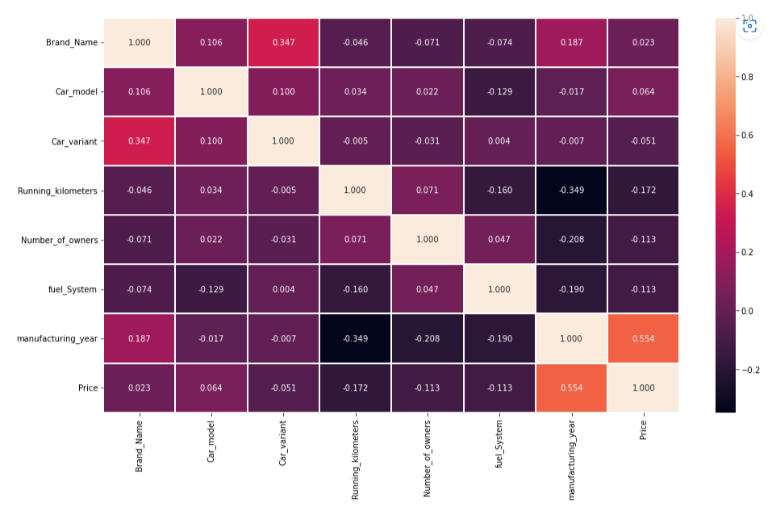
HEAT MAP

Slide 25
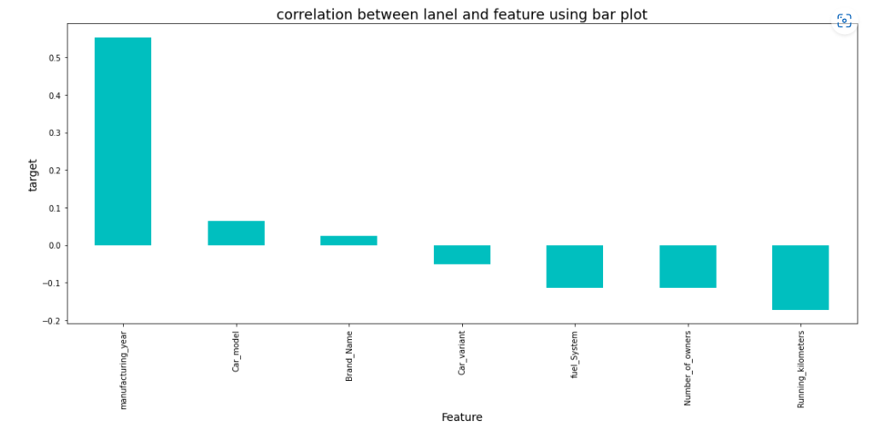
correlation between label and features

Slide 26
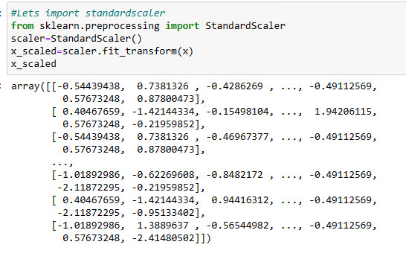
standardscaler

Slide 27
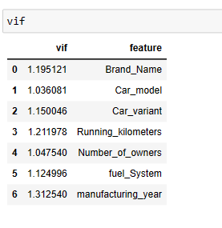
VIF

Slide 28
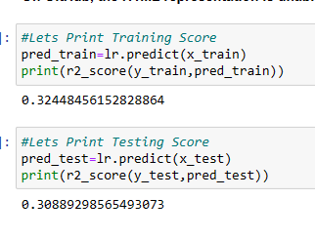
Logistic Regression

Slide 29
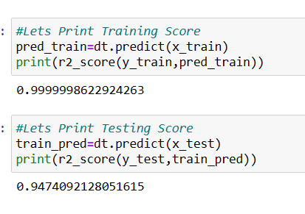
Decision Tree Regressor

Slide 30
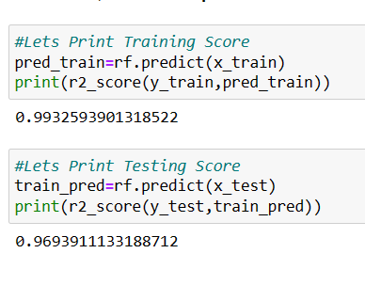
Random Forest

Slide 31
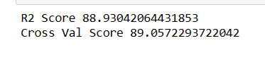
hyperparameter tuning. with Random Forest Regressor

Slide 32
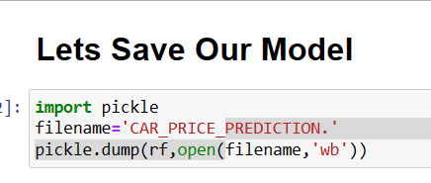
Save Our Model

Slide 33
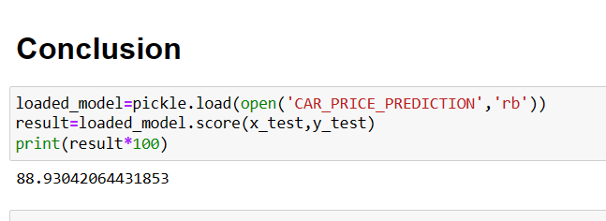
Conclusion

Slide 34

Flip Robo Technologies

